Slide 1
Hands-on with OpenAI API

Slide 2
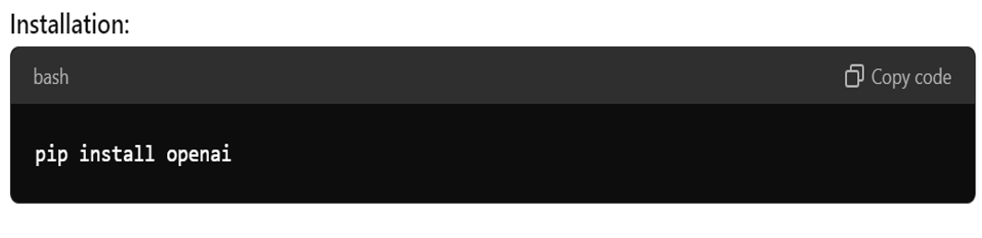

Slide 3
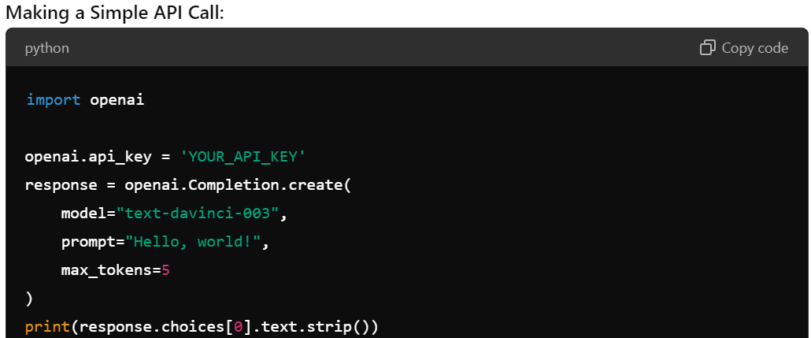

Slide 4
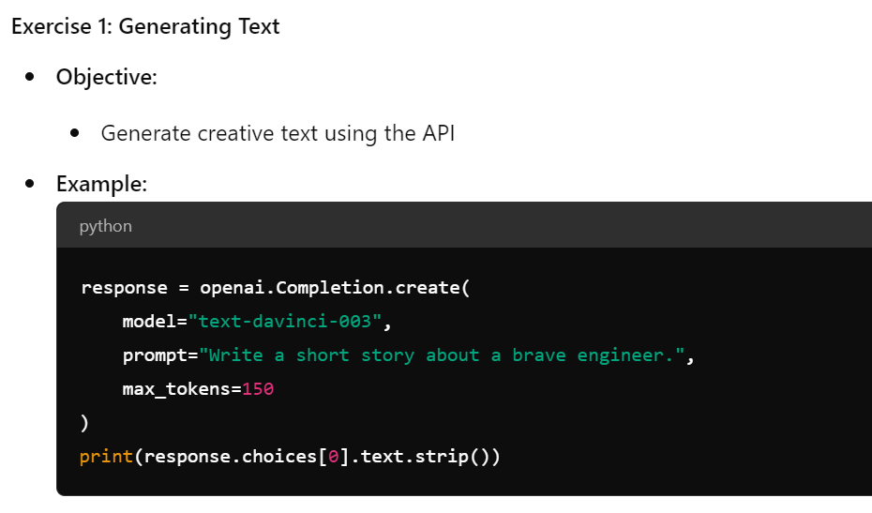

Slide 5
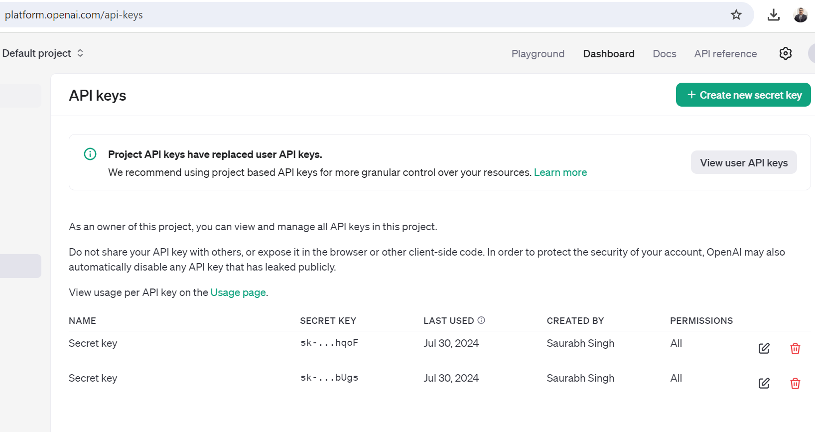

Slide 6
Open Source APIs

Slide 7
Hugging Face Transformers
An open-source library for natural language processing tasks.
Provides pre-trained models for tasks like text generation, sentiment analysis, and translation.
Supports a variety of models including BERT, GPT-2, and T5.

Slide 8
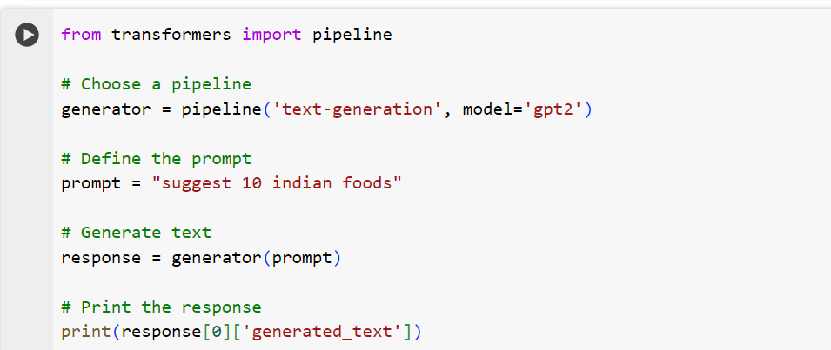

Slide 9
TensorFlow
An open-source platform for machine learning developed by Google.
Provides tools for building and deploying ML models across different environments.
TensorFlow Hub offers a repository of reusable machine learning modules.

Slide 10
PyTorch
An open-source deep learning framework developed by Facebook's AI Research lab.
Known for its flexibility and ease of use.
Provides tools for building and training neural networks.

Slide 11
spaCy
An open-source library for advanced natural language processing in Python.
Designed specifically for production use cases.
Includes pre-trained models and support for tasks like part-of-speech tagging, named entity recognition, and dependency parsing.

Slide 12
OpenAI Gym
An open-source toolkit for developing and comparing reinforcement learning algorithms.
Provides a variety of environments to test and train RL models.
Widely used for research and experimentation in the RL community.

Slide 13
How Transfer Learning Works in Generative AI APIs
Pre-trained Models:
Models like GPT-3, BERT, and others are pre-trained on massive datasets.
Fine-tuning:
Adapt the model to a specific task (e.g., text generation, summarization).
Applications:
Text generation, translation, code completion, and more.

Slide 14
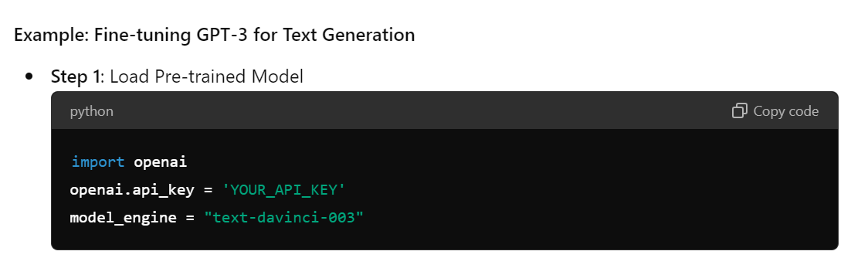

Slide 15
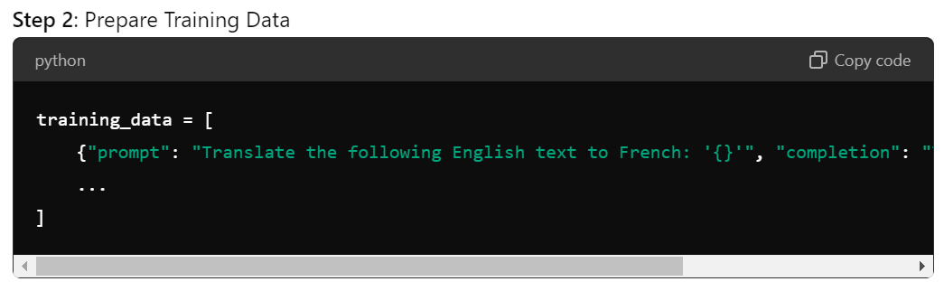

Slide 16
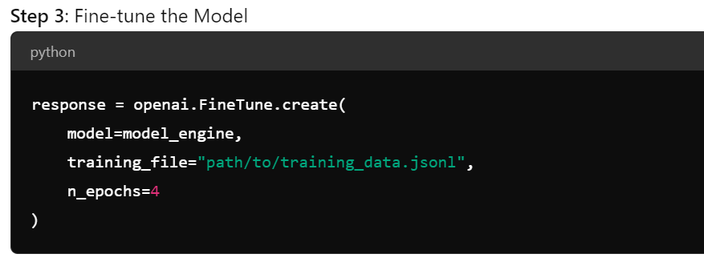

Slide 17
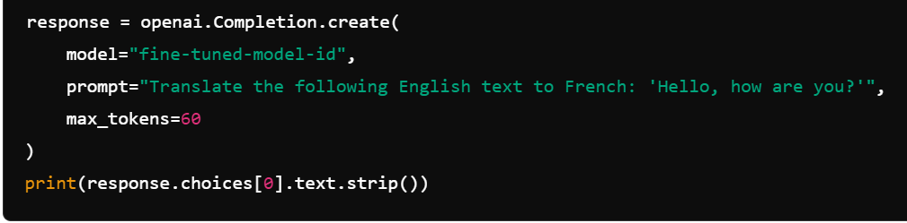

Slide 18
Advantages of Transfer Learning in Generative AI
Efficiency: Leverages existing knowledge, reducing training time.
Performance: Often yields better results with less data.
Versatility: Can be applied to a wide range of tasks with minimal adjustments.

